Slide 1


GOVERNMENT OF KARNATAKA
DEPARTMENT OF TECHNICAL EDUCATION
GOVERNMENT ENGINEERING COLLEGE
Affiliated to Visvesvaraya Technological University, Belagavi ,
Approved by AICTE and Accredited by NAAC, New Delhi
Talakal,Koppal-583238.
DEPARTMENT OF COMPUTER SCIENCE AND ENGINEERING
DBMS MINI PROJECT (18CSL58) ON
“COVID BED SLOT BOOKING SYSTEM”
Presented By:
AYYAPPAYYA SWAMY [2LG19CS009]
LAXMI [2LG19CS017]
MONISH [2LG19CS018]
MALLIKARJUN A G [2LG19CS019]
NAVEEN [2LG19CS024]
SHASHANK [2LG19CS031]
Under the Guidance of:
TEJASWINI ESHWAR ACHAR _{(B.E., M.E.)}
Assistant Professor

Slide 2
CONTENTS
ABSTRACT
INTRODUCTION
SYSTEM MODEL
REQUIREMENT SEPECIFICATION
SYSTEM DESIGN
SYSTEM IMPLEMENTATION
TRIGGERS
RESULTS
CONCLUSIONS
FUTURE ENHANCEMENT
BIBLIOGRAPHY

Slide 3
ABSTRACT
Health care systems are at the front line to fight the COVID-19 pandemic. Emergent questions for each hospital are how many general ward and intensive care unit beds are needed, and additionally, how to optimally allocate these resources during demand surge to effectively save lives. However, hospital pandemic preparedness has been hampered by a lack of sufficiently specific planning guidelines. In this paper, we developed a hybrid computer simulation approach, with a system dynamic model to predict COVID-19 cases and a discrete-event simulation to evaluate hospital bed utilization and subsequently determine bed allocations. Two control policies, the type-dependent admission control policy and the early stepdown policy, based on patient risk pro filing, were proposed to lower the overall death rate of the patient population in need of intensive care.

Slide 4
INTRODUCTION
The lack of adequate number of hospital beds to accommodate the covid positive patients is a main problem in public hospitals.
For controlling the occupancy of bed, we design a dynamic system that announces status of available beds.
This system provides a wide network in the city for bed management that help us to distribute patient in hospitals.

Slide 5
SYSTEM MODEL
Input analysis
The daily COVID hospitalizations are not time homogeneous and are closely related to the number of people infected. In particular.
DES model conceptualization
A DES model based on the general patient flow in hospital COVID units was developed using commercial simulation software, Arena. The scope of the system and the patient flow is described as follows

Slide 6
No
Ward
Elevated
Yes
No
Death
Hospital Arrival
Severe
Yes
Yes
Most
Admission criteria
Yes
No
Elevated
Post ICU ward
D/C
ICU
No
Rejection
Fig. 2.1 Patient flow in the hospital COVID unit under the admission control policy

Slide 7
No
Ward
Elevated
Yes
No
Hospital Arrival
Severe
Death
Yes
Yes
No
No
Post ICU ward
ICU Full
ICU*
Elevated
D/C
Yes
Yes
Trigger early
Stepdown
mechanism
No
Criteria meet
Rejection
Fig. 2.2 Patient flow in the hospital COVID unit under the early step-down policy

Slide 8
REQUIREMENT SPECIFICATION
SOFTWARE REQUIREMENTS:
Frontend- HTML, CSS, PHP, Bootstrap
Backend-Python flask (Python 3.10), SQLAlchemy
• Operating System: Windows 10
• Google Chrome/Internet Explorer
• XAMPP
• Visual Studio Code Editor

Slide 9
HARDWARE REQUIREMENTS:
• Computer with a 1.1 GHz or faster processor
• Minimum 2 GB of RAM or more
• 2.5 GB of available hard-disk space
• 5400 RPM hard drive
• 1366 × 768 or higher-resolution display

Slide 10
SYSTEM DESIGN
USERNAME
HOCE
AIL
DOB
PASSWORD
EMAIL
ADMIN
HOSPITALISER
M
1
N
CAN
ADD
SRFID
USER
N
PASSWORD
CAN
ADD
EMAIL
CAN
ADD
NORMAL BED
N
HCODE
HOCE
VBED
BEDTYPE
SRFID
M
NORMAL BED
HOCE
HOSPITALDATA
VBED
BOOKINGPATIENT
HNAME
ICUBED
TRIG
DATE
HICUBED
SPO2
PADDRESS
N
PPHONE
QUERY
M
CAN
ADD
HICUBED
ICUBED
Fig. ER Diagram

Slide 11
SCHEMA DIAGRAM
admin
Username password
Hospital user
Email password hcode
Hospital data
nbed Vbed kubed hicubed hname hcode
trig
Nbed vbed date hicubed icubed hcode query
user
Email DOB srfid
Book patient
hcode bedtype paddress pphone srfid spo2

Slide 12
SYSTEM IMPLEMENTATION
1 HTML: IT IS THE STANDARD
Hypertext Markup Language (HTML) is the standard markup language for creating web pages and web applications.
2 CSS:
Cascading Style Sheets (CSS) is a style sheet language used for describing the presentation of a document written in a markup language.
3 SQL:
Structured Query Language (SQL) is the language used to manipulate relational databases.

Slide 13
4 PHP Language:
PHP is a server-side scripting language designed primarily for web development but also used as a general-purpose programming language
5 Database:
A Database Management System (DBMS) is computer software designed for the purpose of managing databases, a large set of structured data, and run operations on the data requested by numerous users.
6 Xampp Server:
Xampp server installs a complete and ready-to-use development environment.

Slide 14
TRIGGERS
It is the special kind of stored procedure that automatically executes when an event occurs in the database.
Triggers used:
1. Trigger name: on insert
Table: register
Time: after
Event: insert
Definition: INSERT INTO trig VALUES (null, NEW.rid, 'Farmer
Inserted', NOW ())
2. Trigger name: on delete
Table: register
Time: after
Event: delete

Slide 15
Definition: INSERT INTO trig VALUES (null, OLD.rid, 'FARMER
DELETED', NOW ())
3. Trigger name: on update
Table: register
Time: after
Event: update
Definition: INSERT INTO trig VALUES (null, NEW.rid,' FARMER
UPDATED', NOW ())

Slide 16
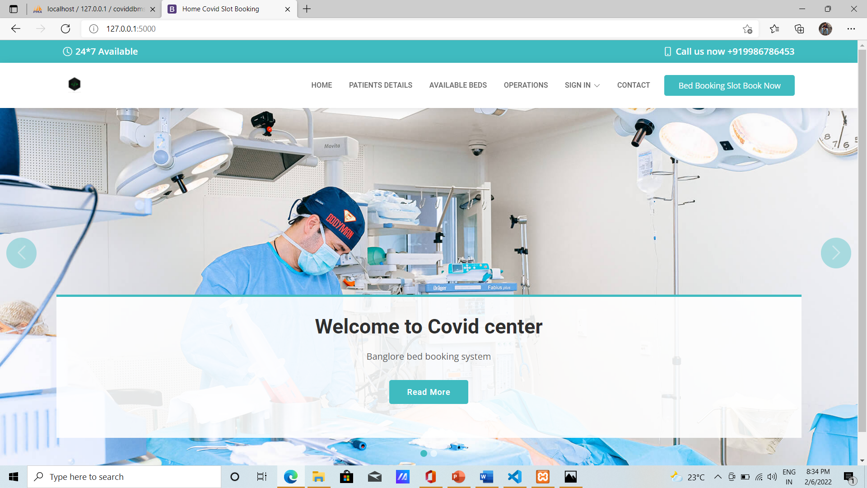
RESULTS
HOME PAGE

Slide 17
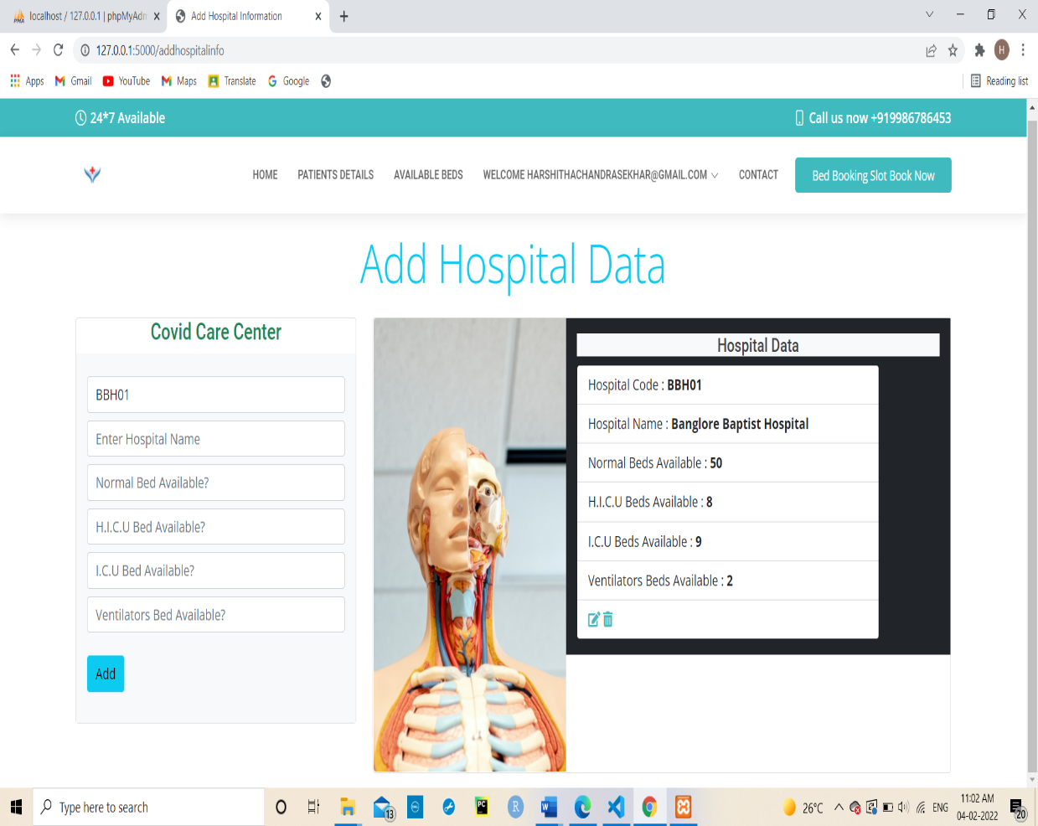
ADD HOSPITAL DATA

Slide 18
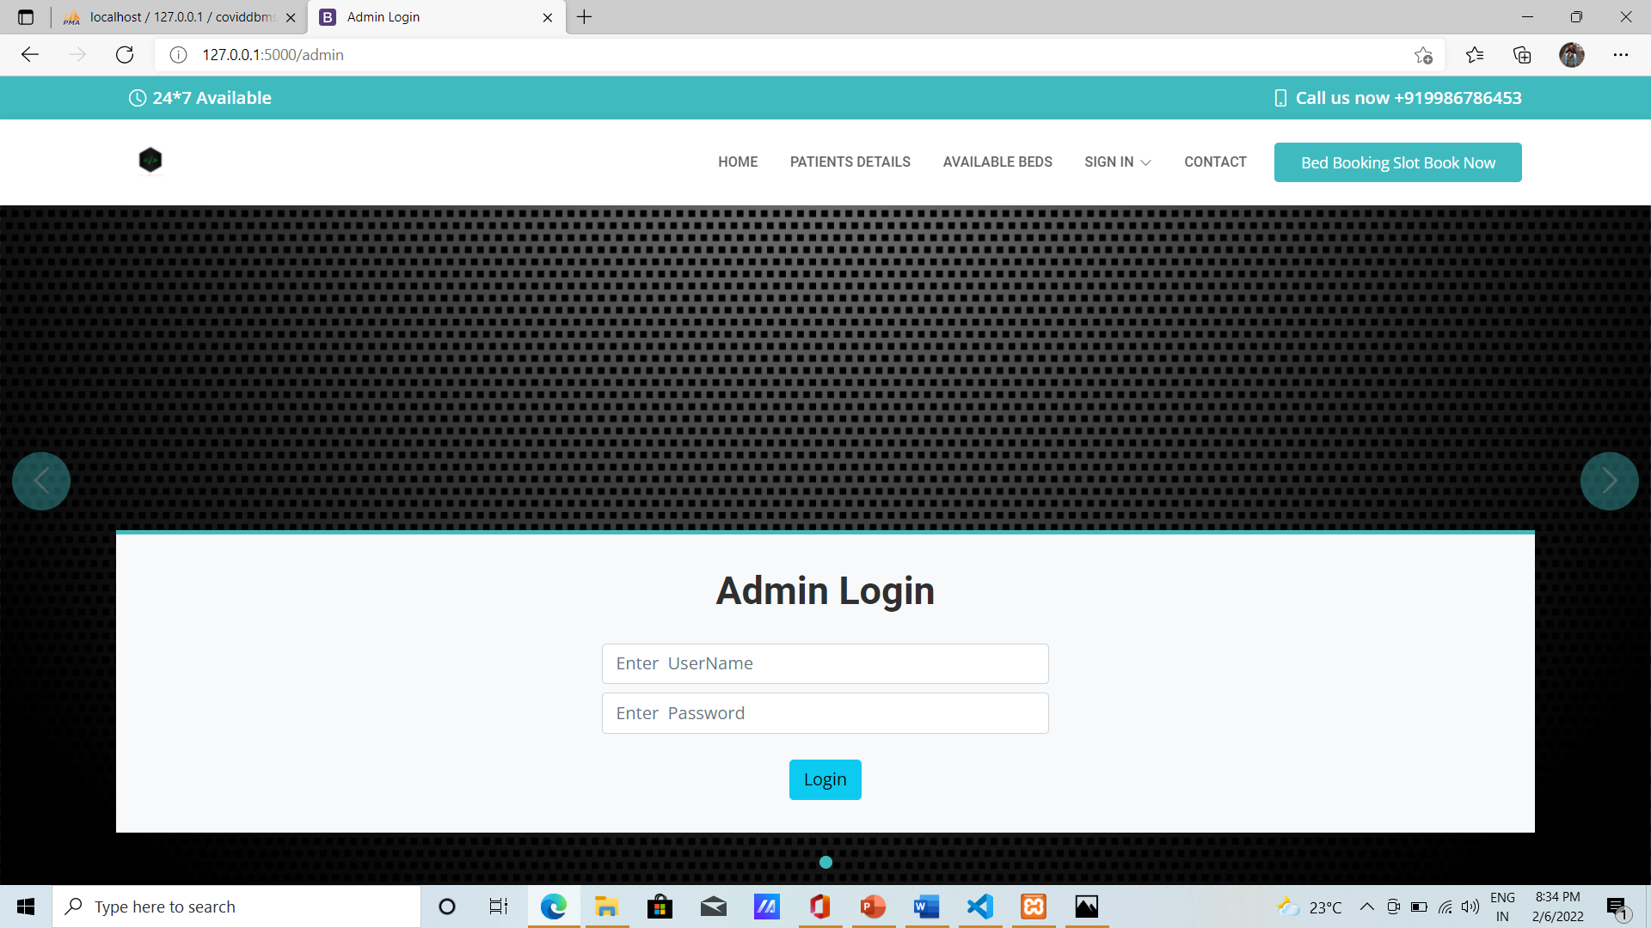
ADMIN LOGIN

Slide 19
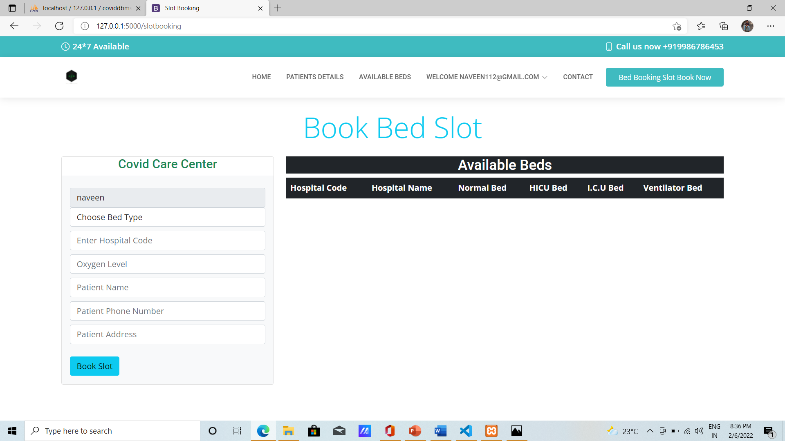
BOOKING BED

Slide 20
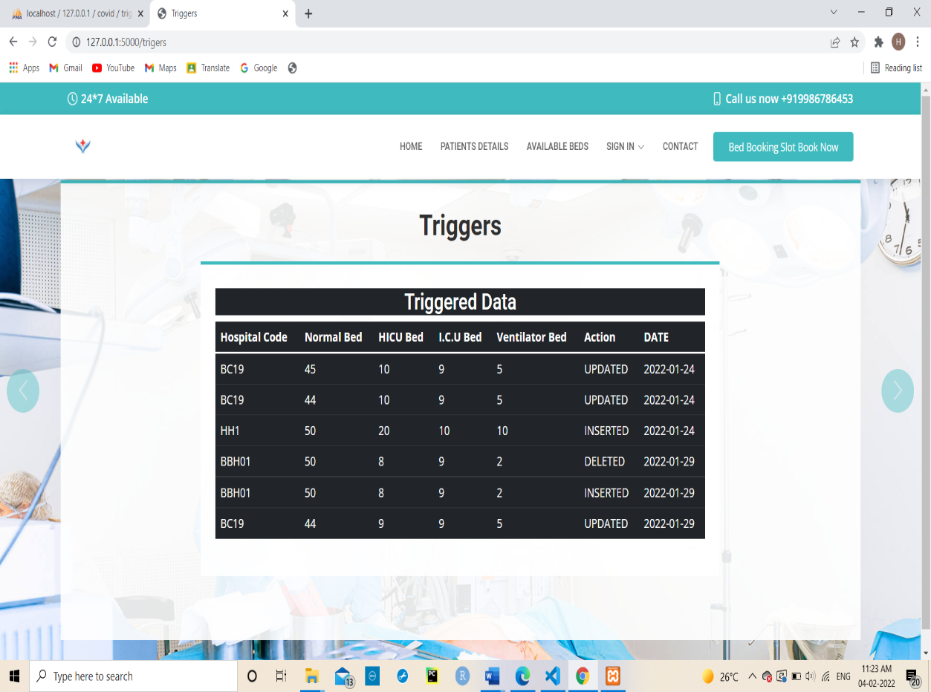
TRIGGERS RECORDS

Slide 21
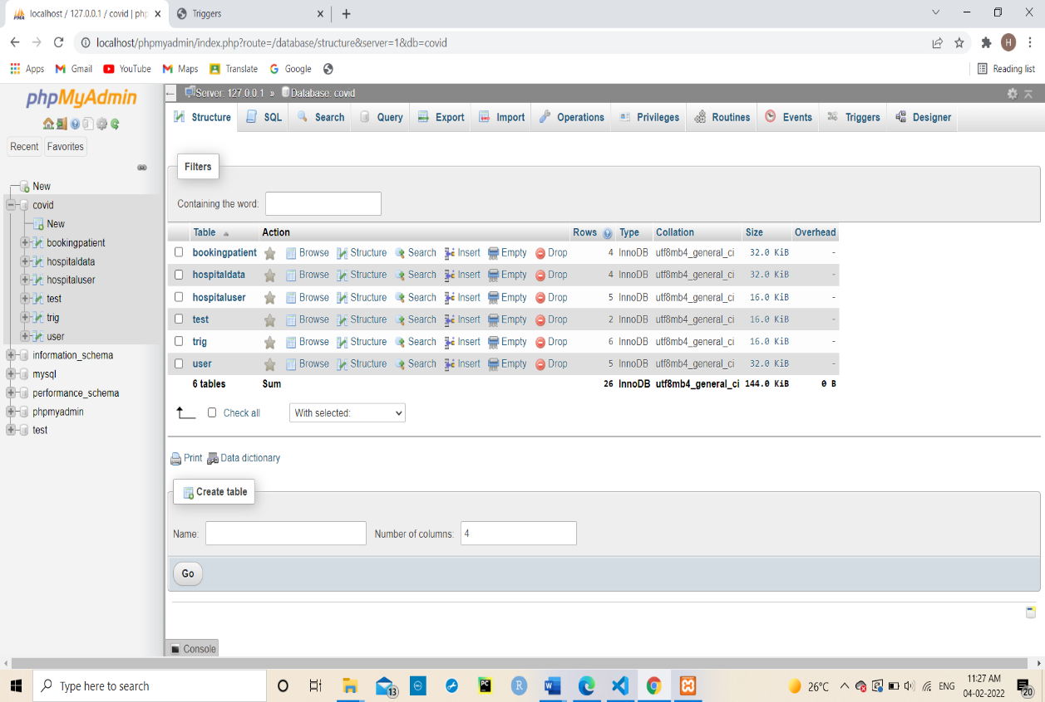
DATABASE LOCAL HOST

Slide 22
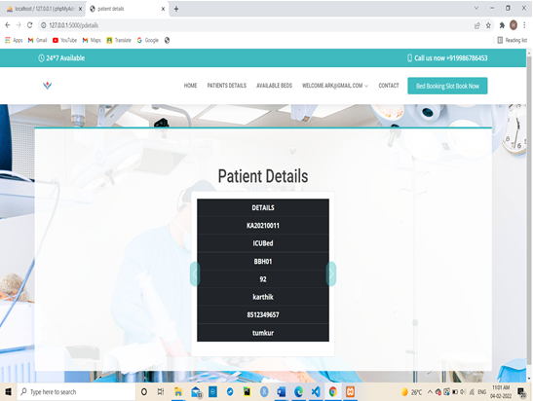
PATIENT DETAILS

Slide 23

HOSPITAL LOGIN

Slide 24
CONCLUSION
Covid Bed Slot Booking successfully implemented based on online data filling which helps us in administrating the data user for managing the tasks performed in students.
The project successfully used various functionalities of Xampp and python flask and also create the fully functional database management system for online portals.
Using MySQL as the database is highly beneficial as it is free to download, popular and can be easily customized.
The data stored in the MySQL database can easily be retrieved and manipulated according to the requirements with basic knowledge of SQL.
• The planning that goes into implementing a project.
• The importance of proper planning and an organized methodology.
• The key element of team spirit and co-ordination in a successful project.

Slide 25
FUTURE ENHANCEMENT
This Project Still has Uncompleted Features and newer version is necessary for upcoming newer technology, we would like to enhance this project by adding features mentioned Below:
Let users fix the date for booking bed slot.
Should provide an automated backup and recovery for security management of information in the hospital.
Generating booking details through SMS or Email facility.
Using SMS or Email facility, we can send remainders to the user about the time left to occupy his bed in the hospital.
Online feedback forms can be implemented.

Slide 26
BIBLIOGRAPHY
1. https://www.youtube.com
2. https://www.google.com
3. http://www.getbootstrap.com

